Slide 1



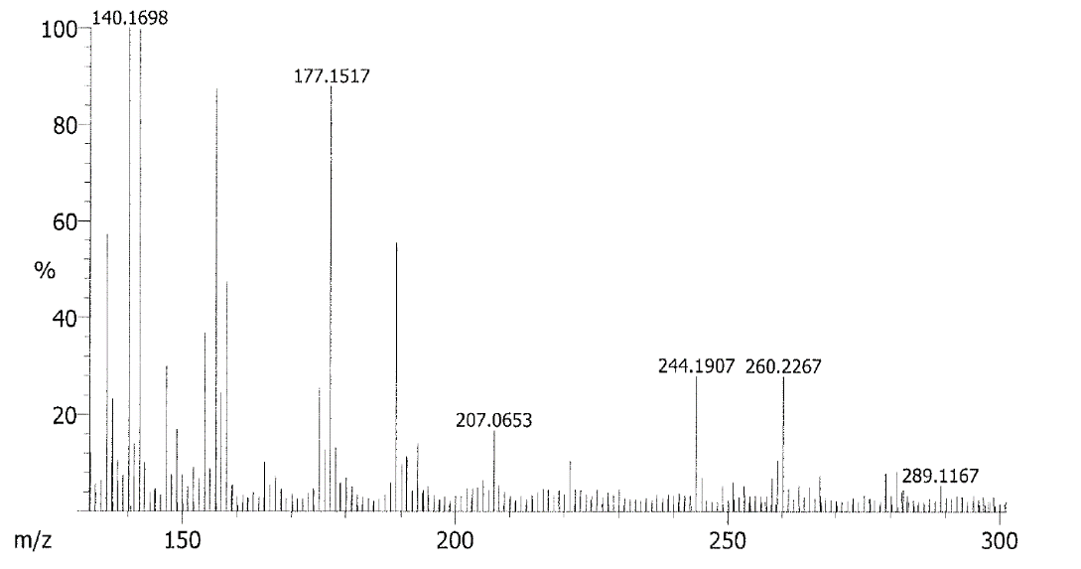
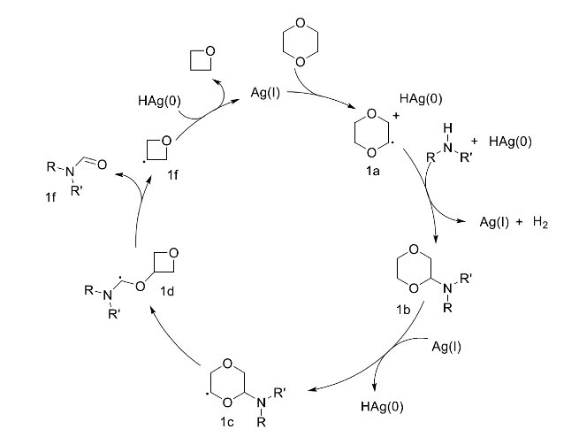
Kinetic and Mechanistic Investigations of a Silver-Catalyzed N-Formylation Reaction
Michelle Wang¹, Bradley King², Kate Jesse¹, Guneet Kaur¹, Brianna Tran¹, Ryan Walser-Kuntz³, Robert G. Iafe⁴, and Anna G. Wenzel¹
¹Keck Science Department, Claremont, CA ; ²Department of Chemistry, Pomona College, Claremont, CA; ³Department of Chemistry, University of Michigan-Ann Arbor, Ann Arbor, MI; ⁴Cal State University, San Marcos, San Marcos, CA
Introduction
Kinetic Studies
Mechanistic Studies
Aniline Kinetic Studies
TEMPO Investigation
N-(2,5-dimethoxyphenyl)formamide
Cancer drug
1-formyl-1,2-dihydroquinoline
Anti-parasitic agent
Formanilidine
Isocyanate Synthesis Precursor
trace
major: TEMPO-dioxane adduct
N-formyl compounds and formamides are pharmaceutically and synthetically relevant targets or intermediates
Usually synthesized with formyl source+amine
M+H
R=OH, CH₃CO₂
Background and Discovery
Figure 1. Average initial rates of formylation reaction using varying concentrations of aniline.
Hammett Plot Study
Figure 3. HRMS FAB+ matrix featuring the mass of identified TEMPO adduct in crude reaction mixture.
Proposed Mechanism
First reported gold-catalyzed intermolecular hydroamination (Zhang et al., 2009)
Not observed
Major Product: 12% yield
p-OCH₃
N-formylated product observed in 12% yield
Optimized, model reaction:
p-CH₃
aniline
p-Cl
Formylation observed in 11 other examples, 21-81% yield
1,4-dioxane found to be formylation agent, other oligomeric ethylene-oxides viable
KIE: 29:1 H vs. D preference at normal conditions
Initial TEMPO mechanism studies did not suggest radical pathway
Figure 2. Average relative reaction rates of a series of para-substituted anilines organized by Hammett σ_{para} values.
Figure 4. Proposed mechanism for silver-catalyzed N-formylation reaction using 1,4-dioxane as the formylating agent (from R. W-K.).
Conclusions
Acknowledgments
Air tolerance observed, oxetane byproduct detected in crude reactions
Silver catalyzed N-formylation reaction using ethylene glycol-derived, oligomeric ethers
Air/oxygen tolerant with a radical based mechanism and first-order kinetics
Many thanks to Professor Anna Wenzel and members of the Wenzel Group. BK, KJ, GK, and BT all performed extensive work on this reaction prior to this project. The University of Michigan, California Institute of Technology, Harvey Mudd College, and CSUSM all provided valuable intellectual contributions.
This project is supported by the National Science Foundation and work was performed in the Keck Science Department.
References
Zeynizadeh, B. and Abdollahi, M. Curr. Chem. Lett. 2016, 5(2), 51
Kobayashi, K. et al., Chem. Lett. 1995, 24(7), pp. 575-576
Faraj, M. K., US5686645, Nov. 11, 1997.
Strazzolini, P. et al. Tetrahedron 1990, 46(4), pp. 1081-1118
Zhang et al. J. Am. Chem. Soc., 2009, 131(15), pp. 5372-5373.
King, B. Oligomeric Ethylene Oxide-Mediated N-Formylation of Amines, Pomona College, Claremont, CA, 2017.

