Slide 1

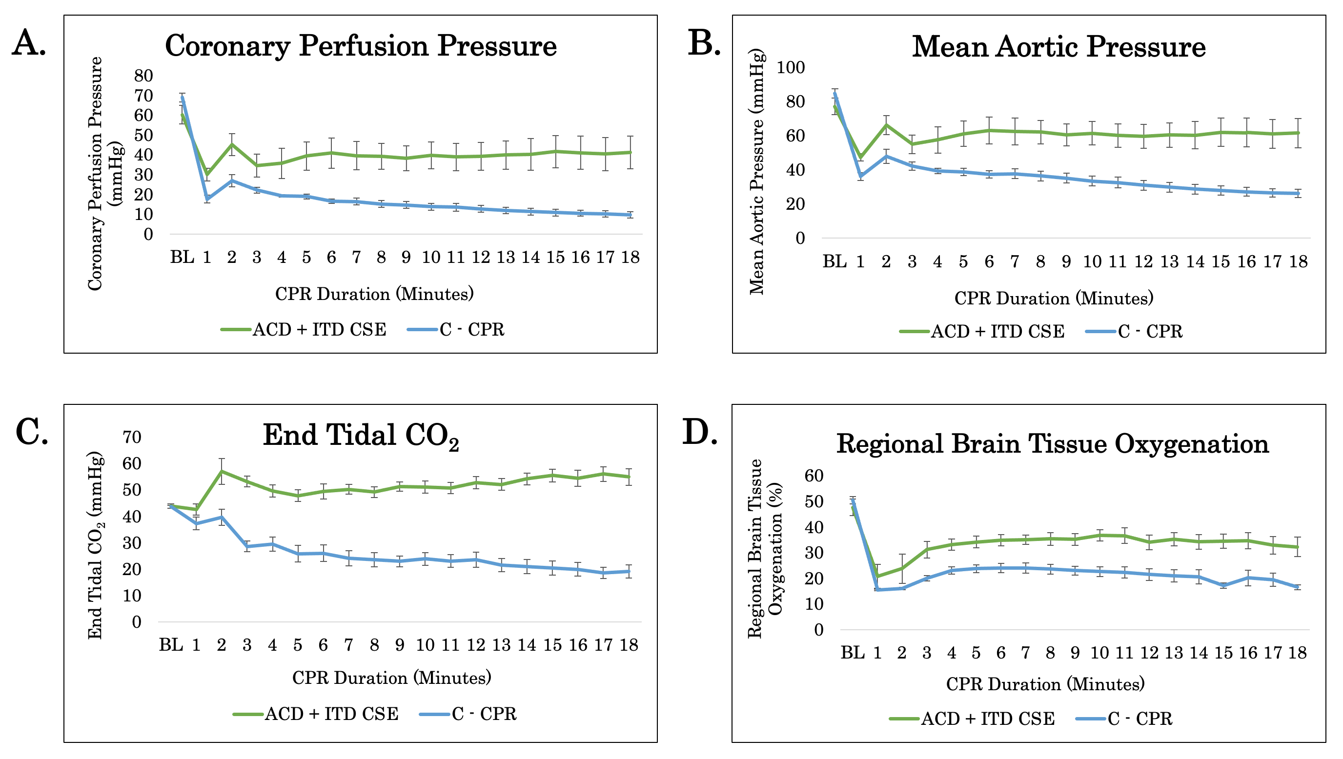
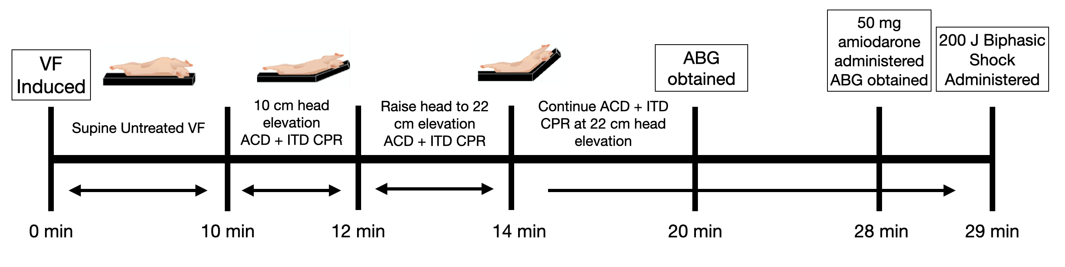
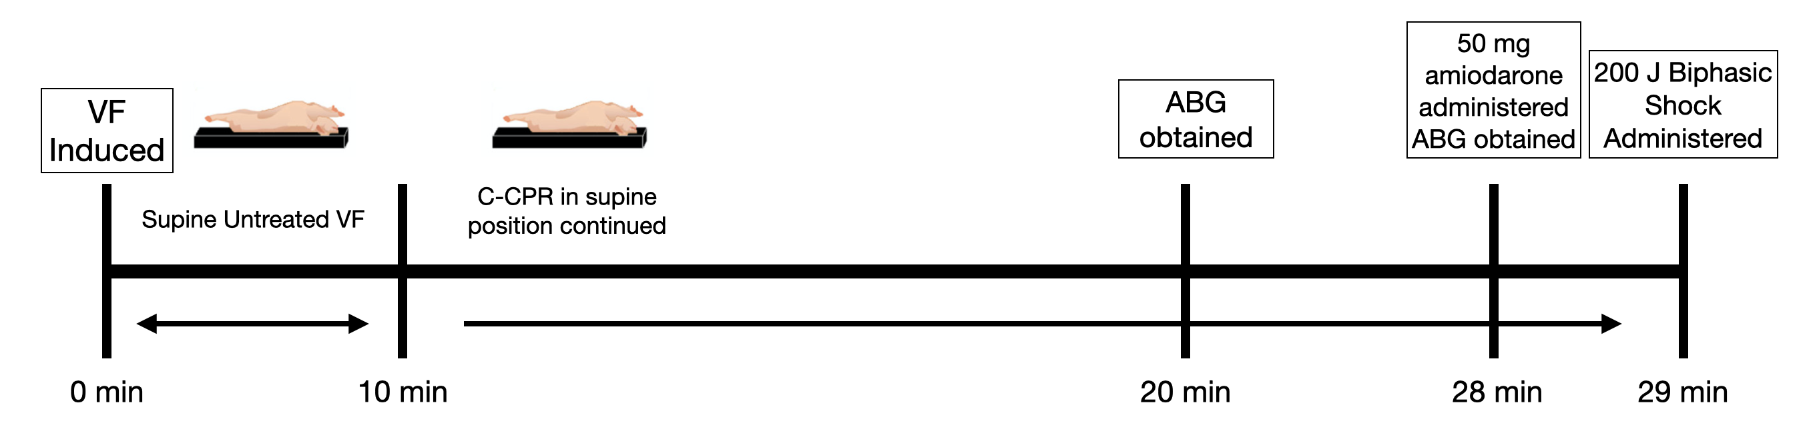
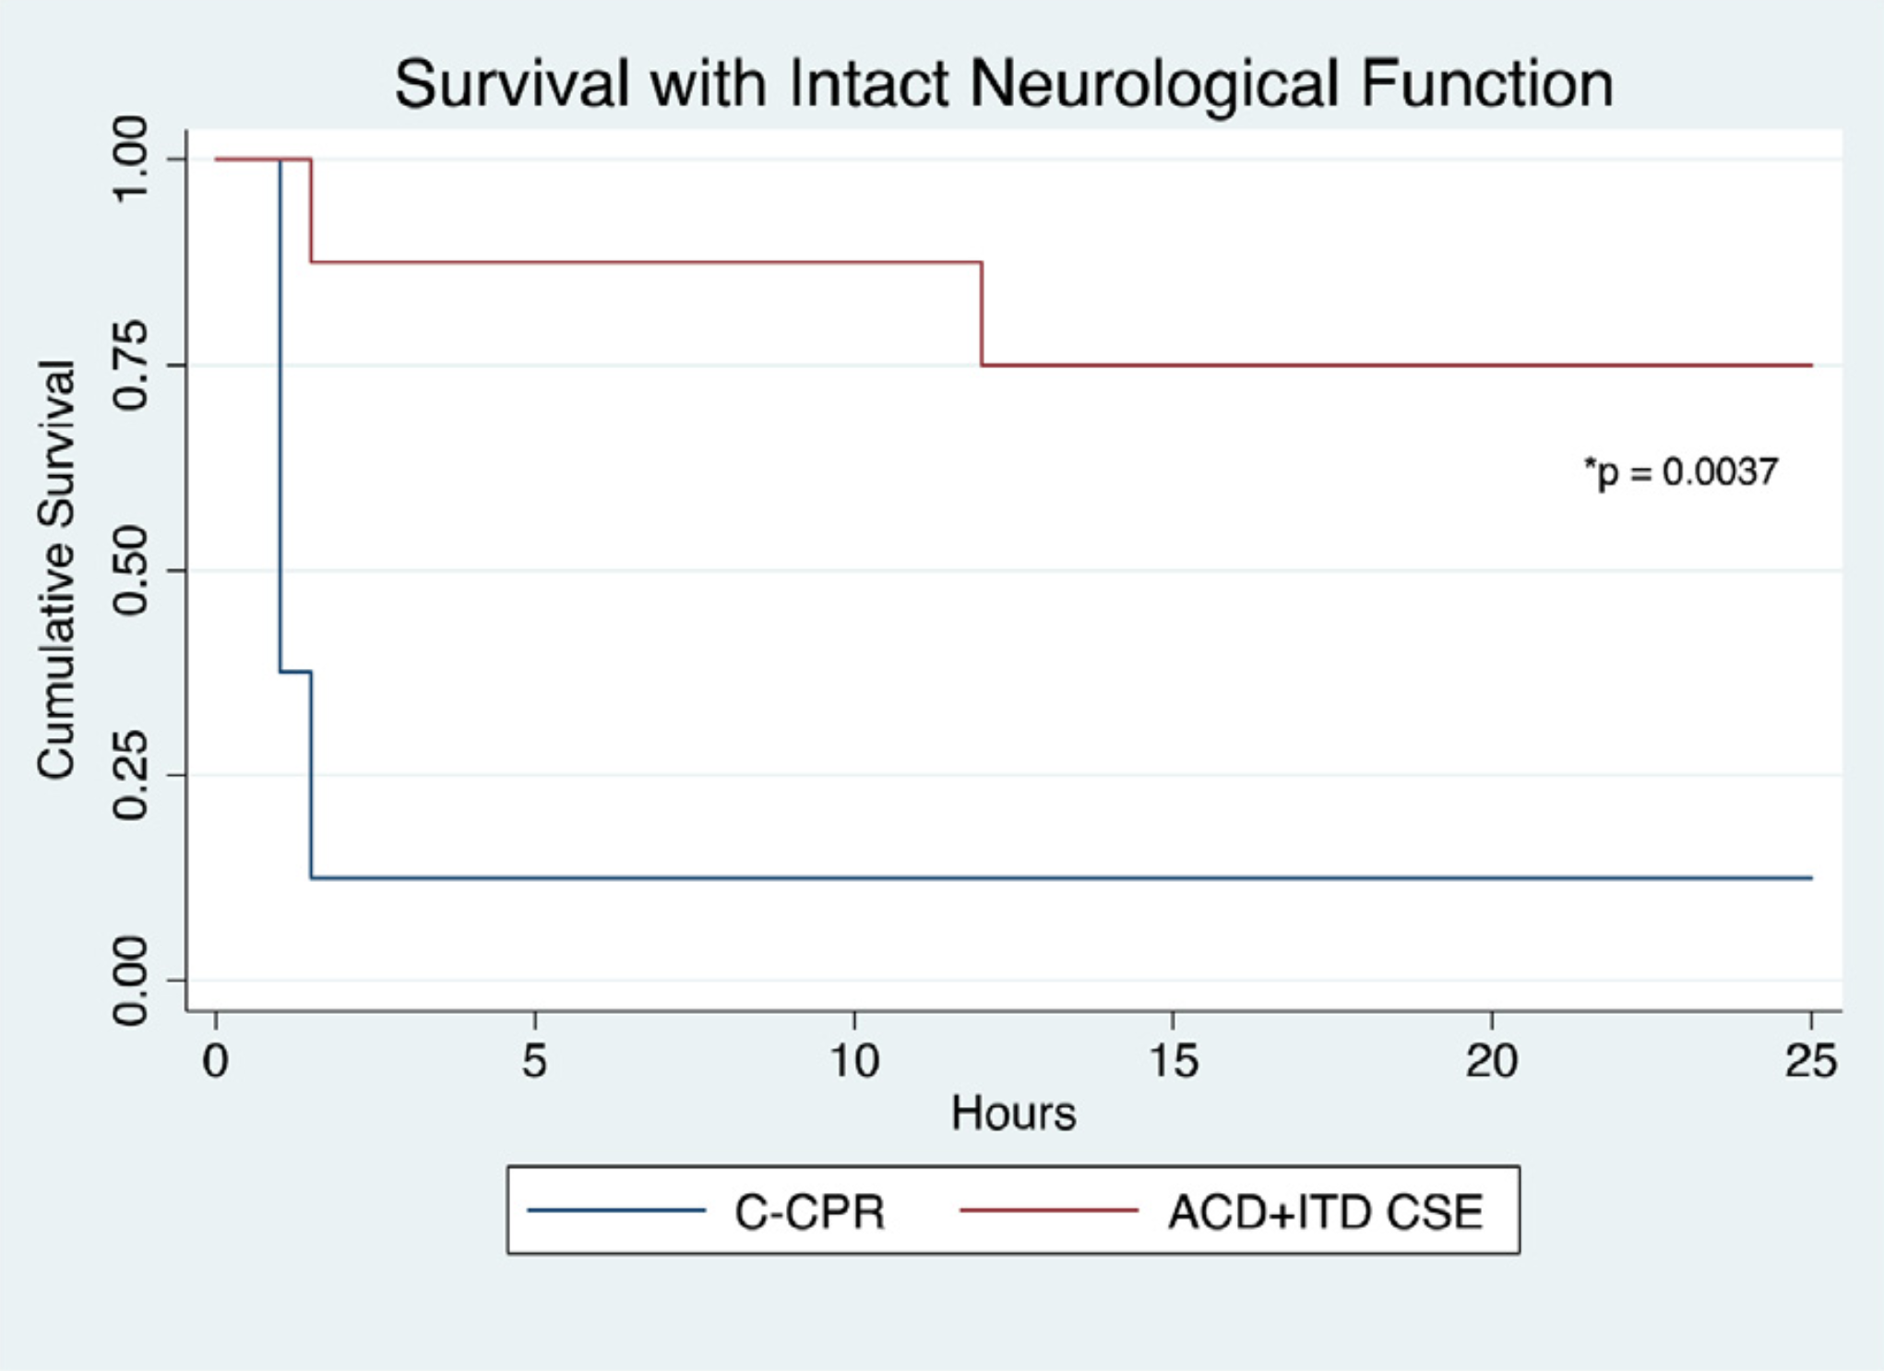
Neuroprotective Benefits of Active Compression Decompression (ACD), Impedance Threshold Device (ITD), and Controlled Sequence Elevation (CSE) Methodology in Cardiac Resuscitation
Natalie Tsai ^{b,d}, Johanna C. Moore, MD ^{a,b,c}, Keith G. Lurie MD ^{b,c}, Anja Metzger, PhD ^{b}, Michael Lick ^{b}, Bayert Salverda ^{b}
ª Department of Emergency Medicine, Hennepin Healthcare, Minneapolis, MN, USA, ^{b} Hennepin Healthcare Research Institute, Minneapolis MN, USA, ^{c} Department of Emergency Medicine, University of Minnesota, Minneapolis, MN, USA, ^{d} Scripps College, Claremont, CA, USA
Introduction
Methods
Results
Sudden cardiac arrest is a state in which an individual’s heart suddenly stops beating and blood flow to the rest of the body is inadequate. Treatment for cardiac arrest requires cardiopulmonary resuscitation (CPR). Current standards of CPR are failing to provide patients with favorable outcomes. Only an abysmal 10% of out-of-hospital sudden cardiac arrest patients survive neurologically intact.
Recent technologies and methodologies have been created to combat poor blood flow:
Active compression decompression (ACD) device & impedance threshold device (ITD): increases blood refill in the heart by creating a negative vacuum in the chest.
Controlled sequence elevation (CSE): gradually raising the head and thorax prevents blood from pooling in the brain and decreases intracranial pressure.
Preparation:
16 female Yorkshire farm pigs weighing approximately 40 kg
Arterial and venous pressures measured using a Millar catheter threaded through the descending thoracic aorta
A differential pressure transducer measured proximal airway pressure, O₂, and ETCO₂ measurements
Experimental Protocol:
Figure 1. ACD + ITD, CSE protocol (n=8)
Figure 2. Conventional CPR (C-CPR) protocol (n=8)
In both protocols, if the animal achieved return of spontaneous circulation (ROSC) after shock, animal was stabilized and monitored for the next 24 hours
Data Collection / Analysis:
Neurological status after 24 hours was calculated using a cerebral performance category score and a neurological deficit score. A neurologically intact outcome was defined as a cerebral performance category score of 1 or 2.
Neurological survival data was analyzed using Fischer's exact test
Hemodynamic values were analyzed using an unpaired student’s t-test
Figure 3. Hemodynamic values between the ACD+ITD, CSE group and C-CPR group during each minute of CPR.
Conclusions
6/8 ACD+ITD, CSE animals achieved neurologically intact survival compared to C-CPR with 1/8 animals that achieved neurologically intact survival (p = 0.0037).
More favorable hemodynamic values were seen in animals undergoing ACD+ITD,CSE
First demonstration of the potential neurological survival benefit associated with ACD+ITD CSE CPR
Objective
Previous animal studies have found usage of ACD, ITD + CSE improved cerebral blood flow compared to standard CPR. Thus, a 24-hour survival study was conducted to determine if there are neuroprotective benefits of using ACD, ITD, and CSE during cardiac resuscitation.
Figure 4. Kaplan Meier Survival Curve comparing the ACD+ITD, CSE group and C-CPR group.
Acknowledgements
References
1. Debaty, G. et al. Tilting for perfusion: Head-up position during cardiopulmonary resuscitation improves brain flow in a porcine model of cardiac arrest. Resuscitation 87, 38–43 (2015).
2. Moore, J. C. et al. Controlled sequential elevation of the head and thorax combined with active compression decompression cardiopulmonary resuscitation and an impedance threshold device improves neurological survival in a porcine model of cardiac arrest. Resuscitation 158, 220–227 (2021).
3. Part 1: Executive Summary: 2020 American Heart Association Guidelines for Cardiopulmonary Resuscitation and Emergency Cardiovascular Care. doi:10.1161/CIR.0000000000000918.

